Slide 1
Carbohydrates and Lipids
Dr. Jason R. Mayberry

Slide 2
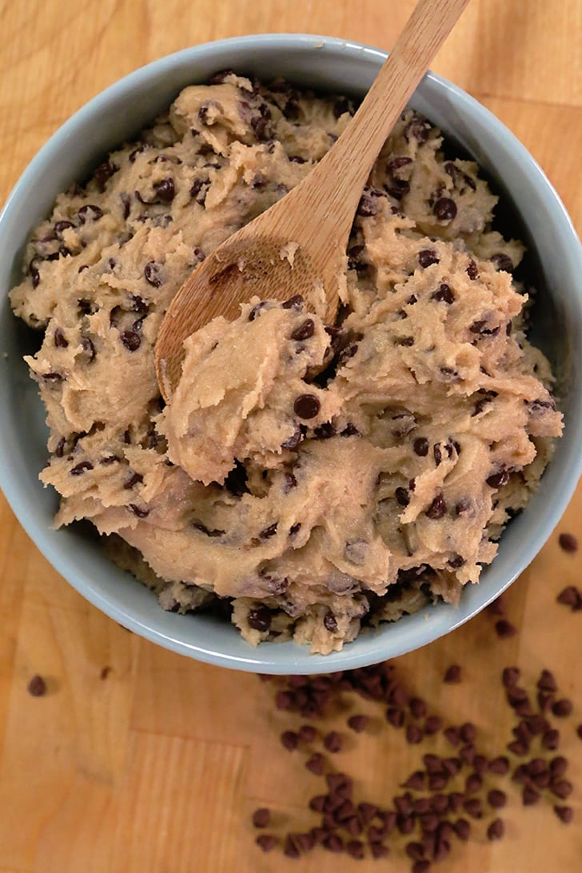
Chocolate Chip Cookie Dough
The Joy of Sugar and Butter
or in other words
Carbohydrates and Lipids

Slide 3
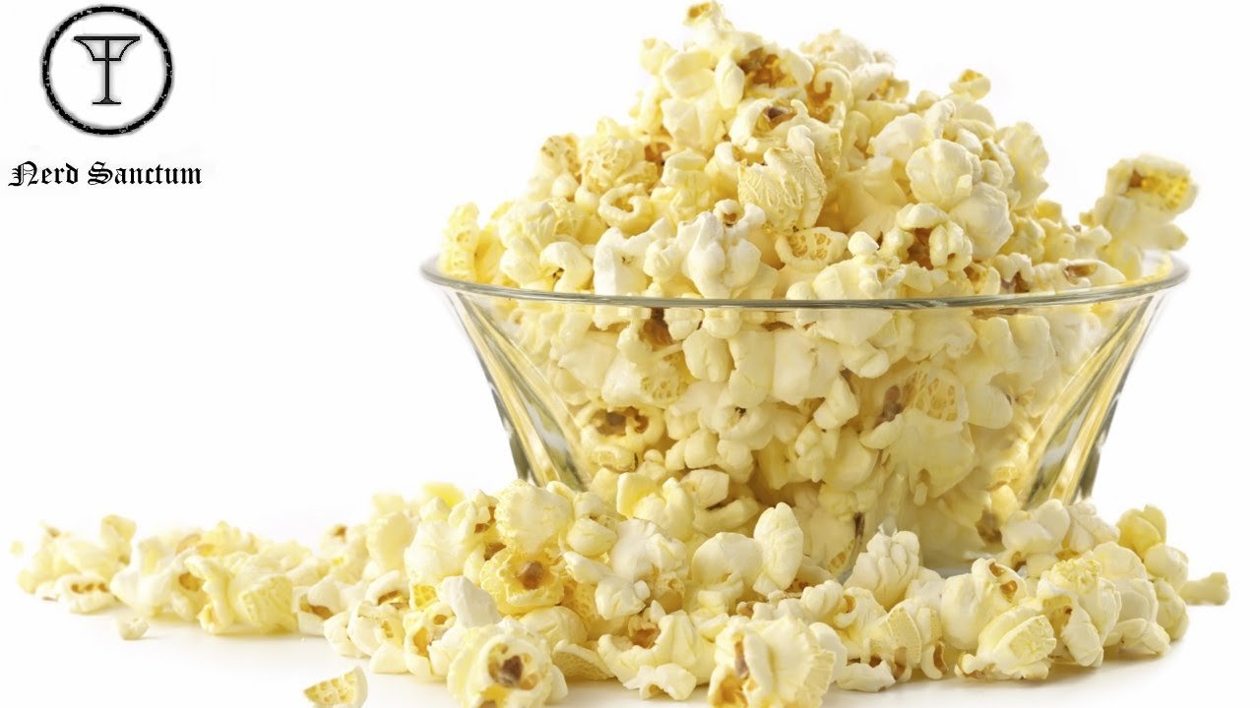
Carbohydrates and Lipids

Slide 4
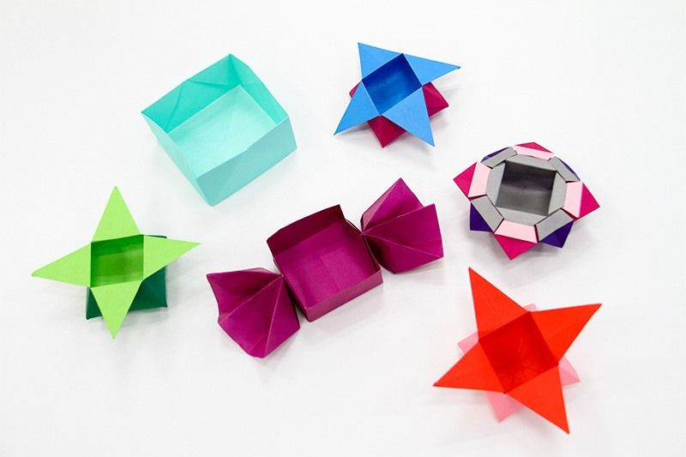
Carbohydrates

Slide 5
LIPIDS
Molecular Building Blocks of Life
Water
Proteins
Nucleic Acids
Carbohydrates
Lipids
Organic Molecules

Slide 6
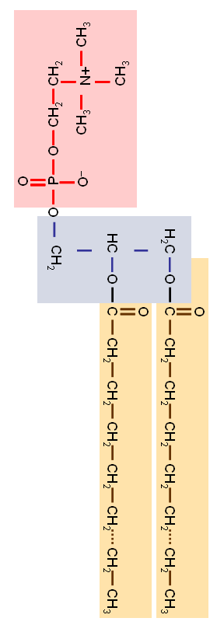
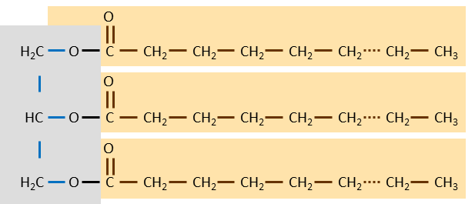
Lipids
Primary Roles of Lipids in Cell Structure and Function
1) All Cell Membranes (Plasma Membrane and Organelle Membranes)
Plasma Membrane
Nucleus
Mitochondria
Endoplasmic Reticulum
Chloroplasts
Peroxisomes
Golgi Apparatus
Vacuole
Transport Vesicles
Lysosome
2) Fat – Long term energy storage (animal cells)
3) Cell Signaling Molecules (Hormones)
OH
OH
O
OH
testosterone
Estradiol

Slide 7
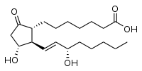
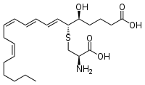
Lipids
Triglyceride
Long Chains of Hydrocarbons (Carbons and Hydrogens) with a few Oxygen Atoms.
Insoluble in Water
Triglycerides (Solid=fat, Liquid=oil)
  Glycerol backbone: Modified simple sugar with three carbons
  Fatty Acid Chain: Carbonic Acid at one end of a long hydrocarbon chain
    Saturated means it has as many hydrogens as possible (solid at room temp, like butter)
    Unsaturated means that in place of pairs of hydrogens, Carbons share double or triple bonds, kinking the chain (liquids at room temp, like oil)
Phospholipids
  Replace one fatty acid chai with a Phosphorous containing group: hydrophilic “head”
  Amphipathic: molecule with hydrophobic and hydrophilic regions
  Basic component of all membranes
Steroids
  Four interlocking hydrocarbon rings
  Cholesterol is modified to form all other steroids in your body (testosterone, estrogen, progesterone, aldosterone etc) as well as Vitamin D and Bile Salts.
Eicosanoids
  Diverse group of 20-carbon fatty acid chains
  Blood clotting , inflammation and labor contractions, etc.
3H₂O
Glycerol
Fatty Acid Chains
O
O
CH
CH₂
CH₃
H₂C
O
H
C
CH₂
HO
CH₂
C
CH₂
CH₂
CH
CH₂
CH₂
CH₂
CH₂
CH₂
CH₃
O
HC
O
H
HO
C
CH₂
CH₂
CH₂
CH₂
CH₂
CH₂
CH₃
O
H₂C
O
H
HO
C
CH₂
CH₂
CH₂
CH₂
CH₂
CH₂
CH₃
Phospholipid
Triglyceride
Phosphate Head
Glycerol
Fatty Acid Chains
O
H₂C
O
C
CH₂
CH₂
CH₂
CH₂
CH₂
CH₂
CH₃
O
HC
O
C
CH₂
CH₂
CH₂
CH₂
CH₂
CH₂
CH₃
O
O
O
CH₂
C
CH₂
CH₂
CH₂
CH₂
CH₂
CH₂
CH₃
H₂C
O
OH
H⁺
O
P
O
CH₂
CH₂
O
P
–
O
CH₂
CH₂
O–
CH₃
CH₃
CH₃
CH₃
N+
O–
N+
CH₃
CH₃
Cholesterol
CH₃
Some Eicosanoids
CH₃
CH₃
CH₃
CH₃
OH
Prostaglandin
Leukotriene E4

Slide 8
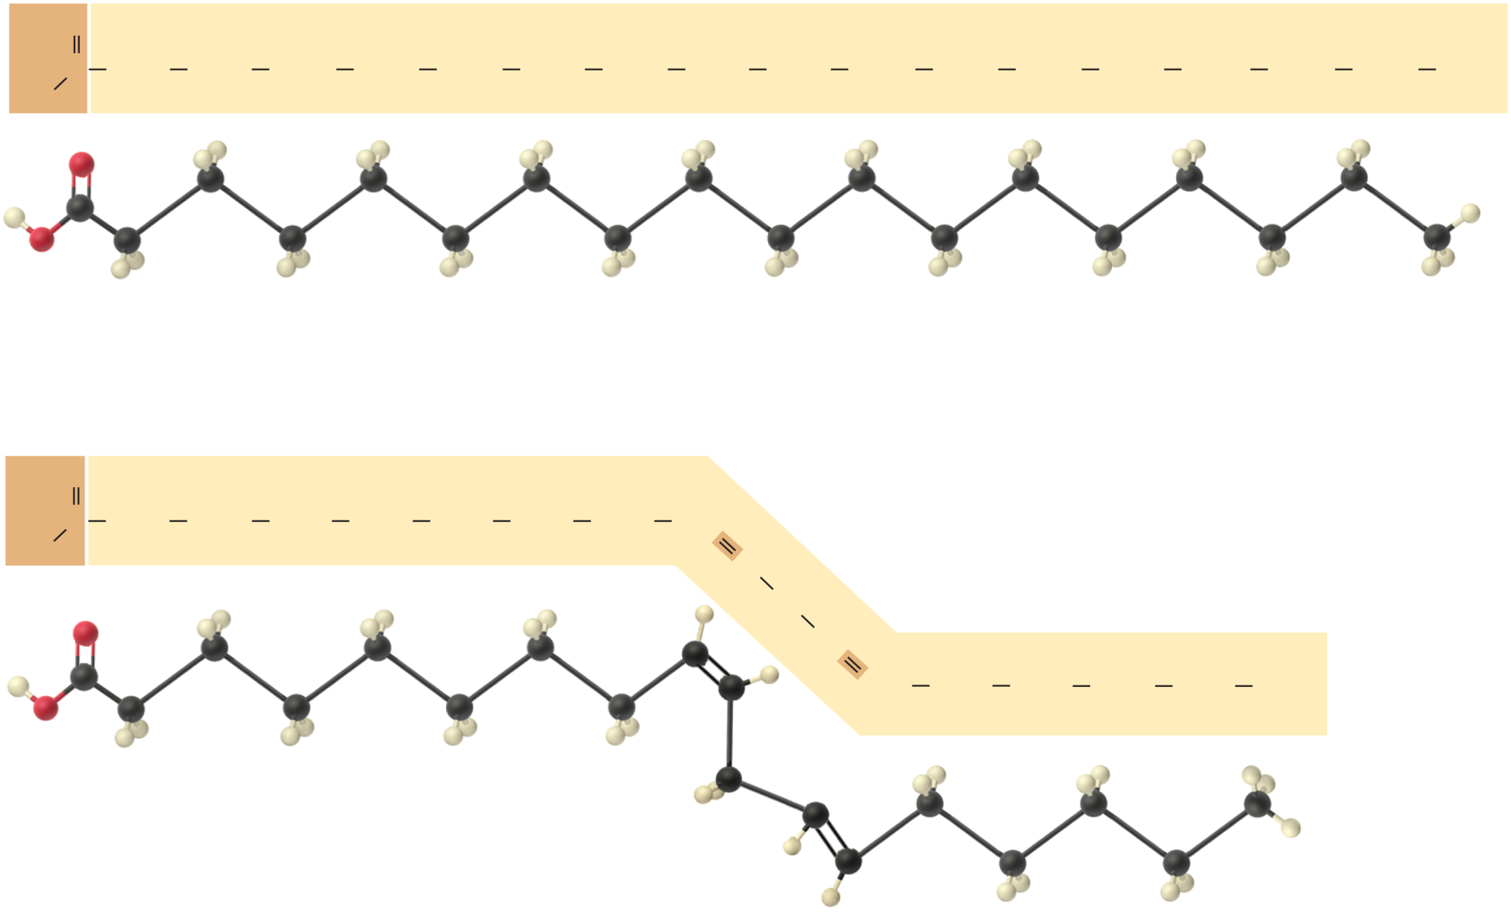
Saturated vs. Unsaturated Fatty Acids
O
C
CH₂
CH₂
CH₂
CH₂
CH₂
CH₂
CH₂
CH₂
CH₂
CH₂
CH₂
CH₂
CH₂
CH₂
CH₂
CH₂
CH₃
HO
Saturated fatty acid
(Stearic acid)
O
C
CH₂
CH₂
CH₂
CH₂
CH₂
CH₂
CH₂
CH
HO
CH
CH₂
CH
CH
CH₂
CH₂
CH₂
CH₂
CH₃
Unsaturated fatty acid
(Linoleic acid)

Slide 9
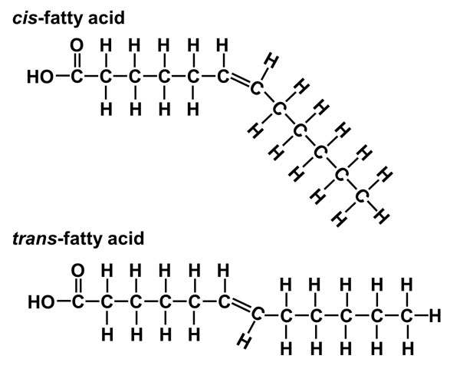

Slide 10
Simplified Drawings - Lipids
Triglyceride
Phospholipids
P
C
C
C
C
C
C

Slide 11
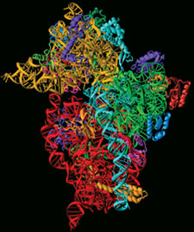
Membranes
The heads of phospholipids are Hydrophilic
The tails of phospholipids are Hydrophobic
Phospholipids line up with their heads next to each other and their tails next to each other
  Tails experience Van Der Waals Attraction
  Heads experience Ionic and Hydrogen Bonding
Phosphlipid Bilayer: structure of organic membranes comprised of two layers of Phospholipids lined up with their tails facing each other, so that they don’t have to “see” the water.
“Membranes” like this form spontaneously in water similarly to soap bubbles but are very fragile
Proteins, and Cholesterol (animals) or Phytosterol (plants) molecules mix in with cellular membranes to strengthen them and add functionality.
Carbohydrate groups are bound to some proteins and phospholipid heads.
Hydrophilic (water loving)
Integral Protein
Hydrophobic
(water fearing)
CH₃
CH₃
CH₃
CH₃
CH₃
CH₃
CH₃
CH₃
CH₃
CH₃
CH₃
CH₃
CH₃
OH
CH₃
CH₃
CH₃
CH₃
CH₃
OH
CH₃
CH₃
CH₃
OH
CH₃
CH₃
CH₃
CH₃
OH
OH

Slide 12
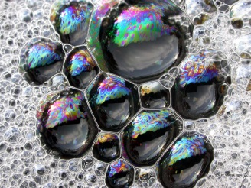
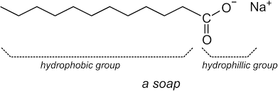
Soap
Soap has a similar amphipathic structure to phospholipids.
Soap Bubbles are soap membranes that form spontaneously in the same was as phospholipids form cell membranes.

Slide 13
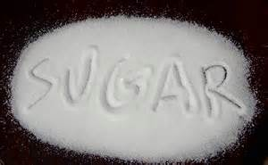
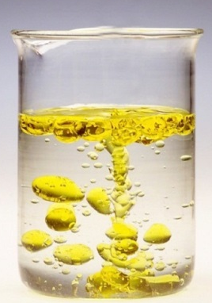
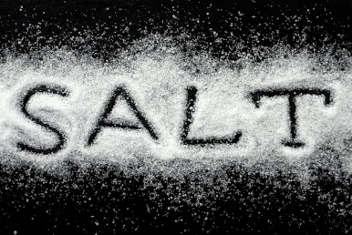
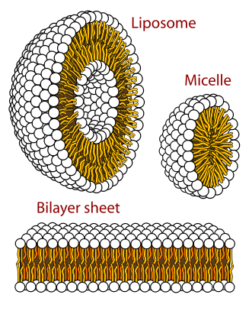
Hydrophilic vs Hydrophobic vs Amphipathic
Hydrophylic: molecules that are water soluble
Hydrophobic: molecules that do not dissolve in water
Amphipathic: molecules that have both Hydrophylic and Hydrophobic parts
Example: Soap, Cell membrane components
Spontaneously form bubbles when mixed in water
Hydrophylic
Hydrophobic
Notes:
Aggregate of prebiotically produced molecules & macromolecules that acquired a boundary, such as a lipid bilayer
Many protocells can exhibit certain properties of life: reproduction and metabolism, and maintain distinct internal chemistry
Protocells may have been fluid-filled vesicles with a membrane-like structure
In water, lipids and other organic molecules can spontaneously form vesicles with a lipid bilayer
Adding clay can increase the rate of vesicle formation (Figure 25.3a) – providing a surface where macromolecules can become concentrated, increasing the likelihood of their reaction
Figure 25.3b – they can reproduce on their own
Figure 25.3c – vesicles can absorb particles in which RNA and other organic molecules are attached to

Slide 14
Organic Soup and the Origin of Life
In the early earth, conditions allowed for organic molecules to form spontaneous chemical reactions.
Organic (Primordial) Soup: Mixture of organic molecules filling the early oceans on earth
Membranes that formed spontaneously trapped organic molecules within.
Protocells: precursors to cells comprised of membranes and the precursor organic molecules that contributed to the emergence of life processes.
Interactions of the organic molecules within protocells were the origin of chemical processes central to all life on earth.
Energy Driven Processes that became photosynthesis and cellular respiration
Genetic Processes controlling Protein Production and Reproduction with Heredity
I⁻
Na⁺
Ca²⁺
H⁺
H⁺
Cl⁻
Cl⁻
Na⁺
H⁺
I⁻
Na⁺
Ca²⁺
H⁺
Ca²⁺
Cl⁻
H⁺
H⁺
Na⁺
I⁻
H⁺
K⁺
Ca²⁺
Ca²⁺
Na⁺
I⁻
Na⁺
Na⁺

Slide 15
Carbohydrates
Molecular Building Blocks of Life
Water
Proteins
Nucleic Acids
Carbohydrates
Lipids
Organic Molecules

Slide 16
Carbohydrates
Primary Roles of Carbohydrates in Cell Structure and Function
H
H
C
OH
C
O
HO
H
OH
C
C
OH
H
H
H
C
C
H
OH
Energy in mitochondria and chloroplast
Short term energy storage (animals)
Long-Energy Storage (plants)
Cell Wall (plants)
Extracellular matrix
Add-ons to some proteins/lipids

Slide 17
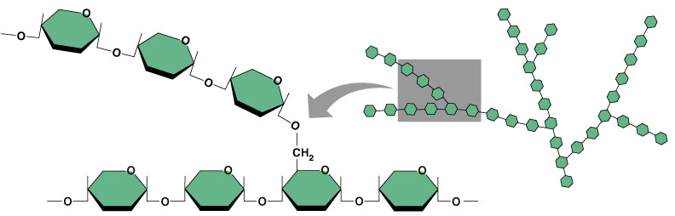

Carbohydrates
Monosaccharide (monomer)
  Structure
    Hydrated (Watered) Carbon Chains; Usually have the ratio CH₂O
    If the chain is long enough, the ends usually connect to make a ring (not by dehydration)
  Examples
    Glucose: 6-carbons; blood sugar
    Pentose: 5-carbons sugar; in Nucleic Acids
    Glycerol: modified 3-carbon sugar-alcohol found in lipids
Disaccharide
  Two monosaccharides join by dehydration
Poly-Saccharide
  Glycogen: Poly-glucose used for storage in animal cells
  Starch: Poly-glucose used for storage in plant cells (not as branched); table sugar
  Cellulose: Poly-glucose molecule with alternating directions of linkage, used for structure in plants. Roughage in animal diets.
H
H
H
OH
O
H
C
C
H
OH
C
C
O
H
OH
C
OH
H
OH
H
C
C
OH
C
H
OH
H
H
H
OH
C
C
C
H
OH
C
H
OH
Glucose
CH₂OH
CH₂OH
CH₂OH
CH₂OH
O
O
O
O
HO
OH
HO
OH
HO
O
OH
H
OH
H
H
OH
H
H
OH
OH
H
OH
OH
OH
OH
H
OH

Slide 18
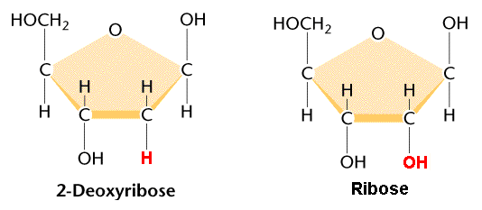
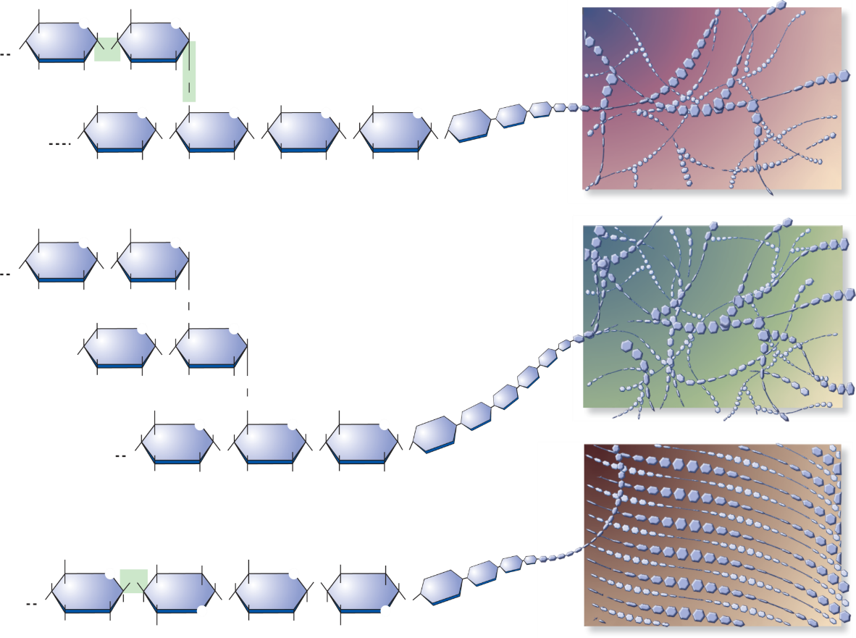
Some Common Carbohydrates
Monosaccharides are comprised of single sugars, usually as rings
CH₂OH
CH₂OH
O
O
H
H
H
HO
OH
OHCH₂
O
OH
H
H
H
HO
CH₂OH
HO
OH
H
OH
H
OH
H
H
OH
H
H
OH
H
OH
Fructose
Glucose
Galactose
CH₂OH
CH₂OH
CH₂OH
CH₂OH
CH₂OH
Disaccharides are composed of two sugars bound together
O
O
O
O
H
H
H
H
H
H
HO
O
H
H
H
H
H
H
OHCH₂
H
O
OH
O
O
HO
OH
H
H
HO
HO
OH
H
OH
H
OH
H
OH
H
H
OH
H
OH
O
CH₂OH
H
OH
H
OH
H
OH
H
OH
H
OH
OH
H
Glucose
Glucose
Galactose
Glucose
Glucose
Fructose
Maltose
(Grain Sugar)
Lactose
(Milk Sugar)
Sucrose
(Table (Fruit) Sugar)
Polysacharides are composed of many monosaccharides bound together
Highly branched
Moderately branched
Unbranched
Glycogen: Animal carbohydrate storage
Starch: Plant carbohydrate storage
Cellulose: Plant carbohydrate based structural molecule

Slide 19

Polysacharides
Branching patterns
6
CH₂OH
6
CH₂OH
5
O
H
H
5
O
H
Moderately branched
4
H
H
H
H
1
O
OH
1
O
4
OH
H
3
2
OH
H
3
2
HO
O
Starch
CH₂OH
6
CH₂
CH₂OH
CH₂OH
H
O
H
H
O
H
H
O
H
H
O
H
H
H
H
H
H
H
H
H
O
OH
O
OH
O
OH
O
OH
O
H
OH
H
OH
H
OH
H
OH
6
CH₂OH
6
CH₂OH
5
O
H
H
5
O
H
Highly branched
4
H
H
H
H
1
O
OH
1
O
4
OH
H
3
2
OH
H
3
2
HO
O
CH₂OH
6
CH₂
Glycogen
H
O
H
H
O
H
H
H
H
H
HO
OH
O
OH
H
OH
H
HO
O
CH₂OH
CH₂
CH₂OH
H
O
H
H
O
H
H
O
H
H
H
H
H
H
H
O
OH
O
OH
O
OH
O
Unbranched
H
OH
H
OH
H
HO
Cellulose
6
CH₂OH
H
OH
CH₂OH
H
OH
H
5
O
1
O
4
3
2
H
H
O
O
H
4
H
H
OH
H
H
H
OH
H
O
OH
H
H
H
O
1
O
OH
H
H
H
O
O
H
3
2
OH
CH
5
H
OH
6
2
OH
CH
2
OH

Slide 20
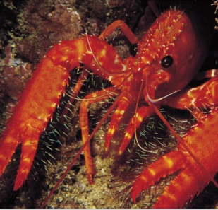
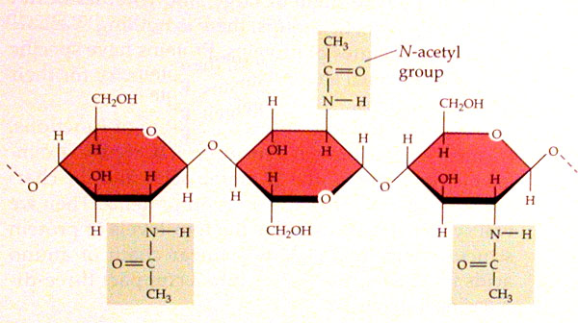
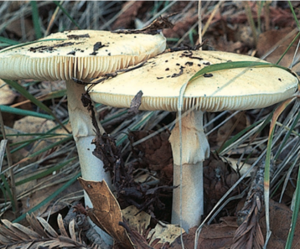
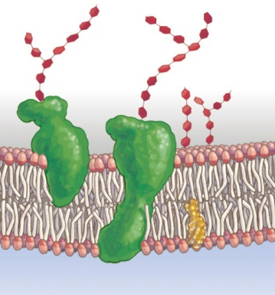
Other Uses for Carbohydrates
Chitin: a polysaccharide used to form the hard exoskeleton of arthropods (insects, crustaceans, etc), and often found in the cell wall of Fungi cells
Chitin
Proteins, and Phospholipids in the plasma membrane often have sugar chains attached which can act as “Dog Tags” for identification
Other Glycoproteins are found in various locations
Sugar Chains
Glycoproteins
Glycolipids
Used as starting material for making other organic molecules: Lipids, Amino Acids (for making proteins), Nucleotides (for making Nucleic Acids like DNA and RNA).

Slide 21
Simplified Drawings - Carbohydrates
HO
O
HO
HO
HO
HO
Monosaccharide (Glucose)
Polysaccharide

